Slide 1




Umrah Travel Agency
Muhammad Dimas | Data Engineering | Nov 25 – Mar 26

Slide 2


Business Perspective
„Finding the Right Hotel at the Right Time“
We guide Muslim travelers in choosing
the right hotel for their journey to Makkah.
Our focus moves beyond „today‘s price“:
we provide visibility on price trends and
availability across different time options,
empowering customers to choose the
optimal travel dates.
Customer-centric mission • Data-driven decisions • Transparent pricing visibility

Slide 3




The Problem
Customer Challenges
Agency Business Risk
Extreme Daily Price Fluctuations
Profit Margin Erosion
Manual Research Inefficiency
Missing Better Deals
Overpaying Without Insights
Competitive Disadvantage
Hotel prices can change drastically overnight – creating a dual-sided crisis

Slide 4
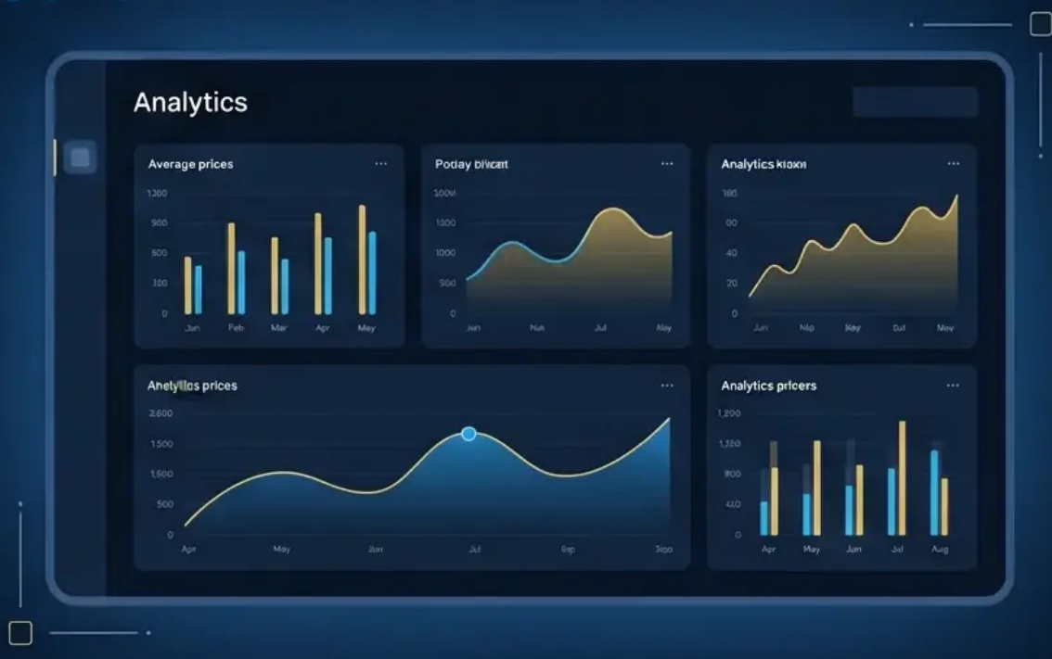



Our Approach
We build an automated data pipeline that fetches raw price and room data from hotel website(s) and deliver them as actionables.
Fetch & Ingest
Transform & Store
Daily scheduled runs
Capture 3-5 star tiers
Raw data storage
Cleanse data anomalies
organize a data warehouse
structure a layered schema
Decision Dashboard
Compare average prices per night across hotel classes (3★, 4★, 5★)
Image shown above only serves as illustration,
not the actual dashboard.
Identify optimal booking horizons (weeks or months in advance)
Key outcome:
Users plan trips more efficiently and
cost-effectively
Overview of hotel availability trends over time

Slide 5















Project Impact
For Customers
For Travel Agency
Make informed decisions based on real data
Reduce manual research effort
Find optimal timing for booking
Improve pricing strategy accuracy
Avoid overpaying for accommodations
Deliver data-driven recommendations
Sample Insights
4-star hotels can be cheaper than 3-star hotels in last-minute scenarios Prices can rise up to 20× higher during peak seasons

Slide 6



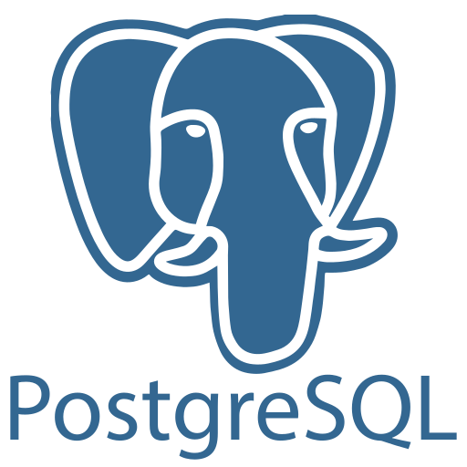

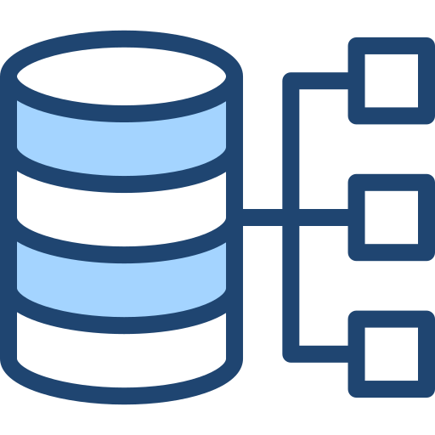






install tools & libraries
build environment
run airflow
Architecture Overview
run selenium
run python scripts
run SQL queries
run dbt
schedule tasks
manage dependencies
manage workflow
monitoring & alerting
3
5
PostgreSQL
push data from local
to cloud database
prepare warehouse
prepare schema
prepare tables
1
4
scrape hotel data
build a dashboard
2
create silver layer
bring hotel data to
data warehouse
create gold layer

Slide 7

Architecture Overview
Ingestion
Web Scraping
Python | Selenium | Xvfb | BS4
Orchestration
Task Scheduling
Airﬂow
Storage
Database
PostgreSQL | NeonDB
Transformation
Data Modeling
dbt
Serving
UI Dashboard
Streamlit

Slide 8
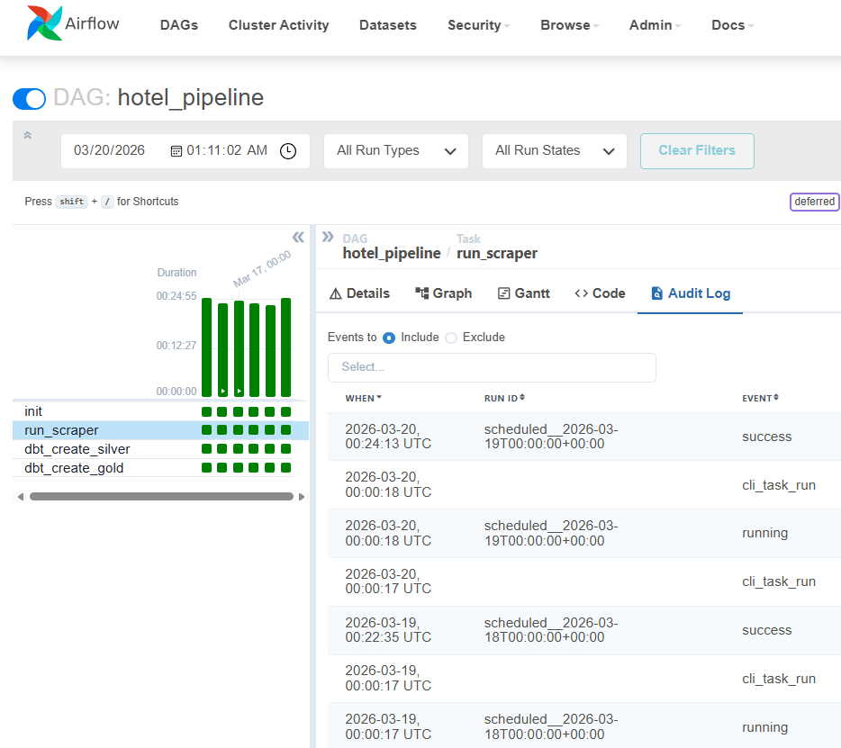
Architecture Overview
Ingestion
Web Scraping
Python | Selenium | Xvfb
What Airflow handles:
Orchestration
Workflow management
Task scheduling
Dependency management
Monitoring & alerting
Task Scheduling
Airﬂow
Storage
Database
PostgreSQL | NeonDB
What it runs:
Transformation
Data Modeling
Python scraper
Dbt transformation script
dbt
Serving
UI Dashboard
Streamlit

Slide 9
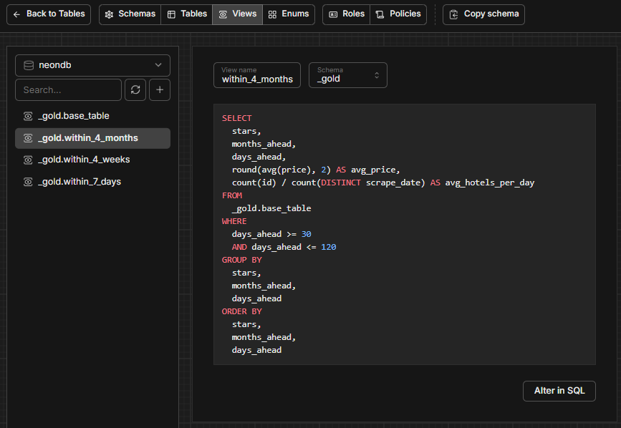
Architecture Overview
Ingestion
Web Scraping
Python | Selenium | Xvfb
Postgres for
Orchestration
Storing fetched data as bronze layer (raw)
Data cleaning & transformation to silver layer
Aggregation to gold layer
Task Scheduling
Airﬂow
Storage
Database
PostgreSQL | NeonDB
Transformation
Data Modeling
Neon DB for
dbt
Storing postgres data in cloud
Free-tier; not limited by time
Serving
UI Dashboard
Streamlit

Slide 10
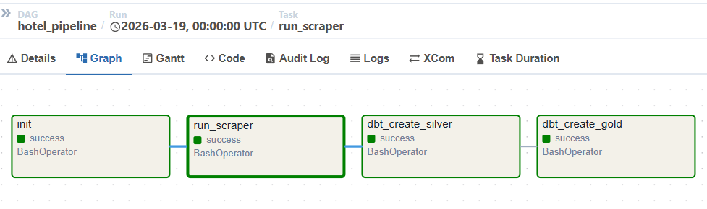
Architecture Overview
Ingestion
Web Scraping
Python | Selenium | Xvfb
Dbt:
Orchestration
Our main transformation engine
Making sure the processes are run in the correct order (first: bronze to silver, then: silver to gold)
Task Scheduling
Airﬂow
Storage
Database
PostgreSQL | NeonDB
Transformation
Data Modeling
dbt
Serving
UI Dashboard
Streamlit

Slide 11

Architecture Overview
Ingestion
Web Scraping
Python | Selenium | Xvfb
Orchestration
Task Scheduling
Airﬂow
Storage
Database
PostgreSQL | NeonDB
Transformation
Data Modeling
dbt
Serving
UI Dashboard
Streamlit

Slide 12






Current Infrastructure
AWS Migration Estimate
Execution:
Local environment (Docker Compose) – €0
Fargate: ~$1.00 -$1.50 /month
EC2(Scheduled): ~$0.30 -$0.50 /month
Storage:
NeonDB (Free Tier) – €0
2000 rows/day, ~500MB limit
< €2.00
Daily
Total Monthly Cost
Execution Frequency

Slide 13
Thank you for participating!
Please be nice with the questions, if any

